Slide 1
Heterogeneous Catalysis
& Solid State Physics
Dohyung Kim
May 2, 2013
Physics 141A

Slide 2
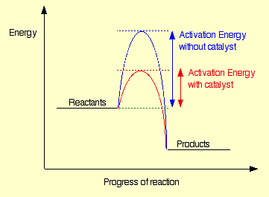
Catalysis
Catalysis : Increase in the rate of reaction due to a catalyst
<http://www.chemguide.co.uk >
Types of Catalysts
Homogeneous : Catalyst and Reactant in the same phase
Heterogeneous : Catalyst and Reactant in different phases

Slide 3
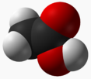
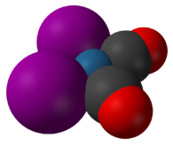
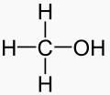
Catalysis
Types of Catalysts
Homogeneous : Catalyst and Reactant in the same phase
e.g.) Organometallic Compounds
<Cativa Process>
Heterogeneous : Catalyst and Reactant in different phases
e.g.) Metal Surface
<Catalytic decomposition of formic acid on noble metals>
<International Journal of Hydrogen Energy Volume 37, Issue 21, 2012, 15956 - 15965>

Slide 4
Heterogeneous Catalysis
Elementary steps in heterogeneous catalysis
Adsorption of reactants
Desorption of products
Reaction of adsorbed intermediates
Adsorptive property of a catalyst = Catalytic activity

Slide 5
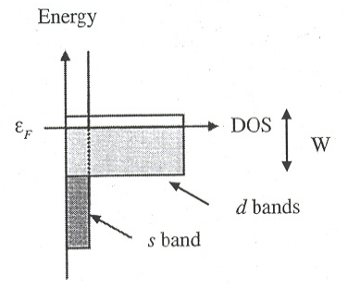
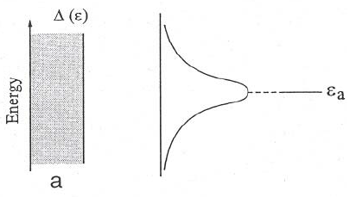
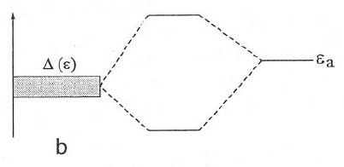
D-band Model(Chemisorption)
Electronic structure of transition metal
Interaction between energy levels
Adsorbate
Adsorbate
Broad band
Narrow band

Slide 6
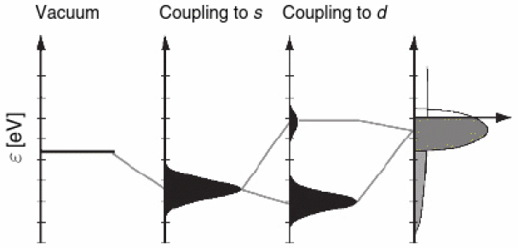
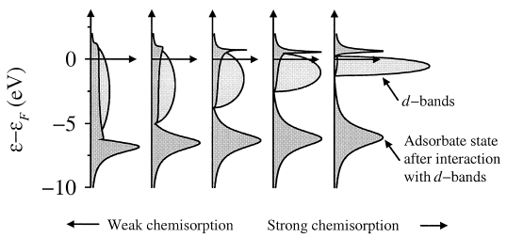
D-band Model(Chemisorption)
Formation of a chemical bond
Antibonding
Bonding
<A. Nilsson et al., Chemical Bonding at Surfaces and Interfaces, Elsevier(2008)>
Strong vs Weak chemisorption
Ed - EF
<B. Hammer et al., Advances in catalysis, Vol. 45(2000), 71-129>

Slide 7
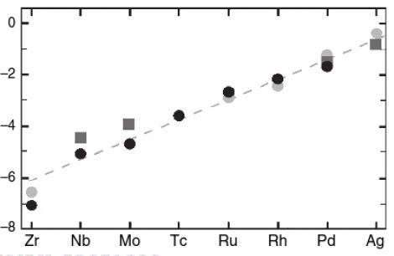
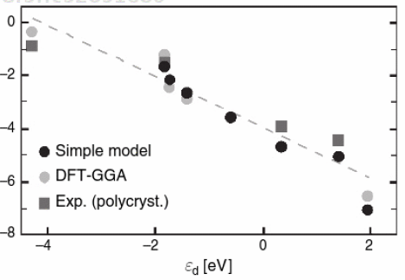
D-band Model(Chemisorption)
Variation in adsorption energies
Different Metal catalysts
ΔE(eV)
<B. Hammer et al., Advances in catalysis, Vol. 45(2000), 71-129>
# of d-electrons
Ed - EF

Slide 8
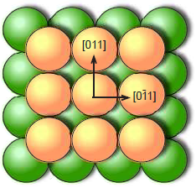
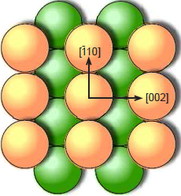
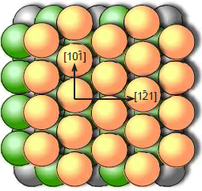
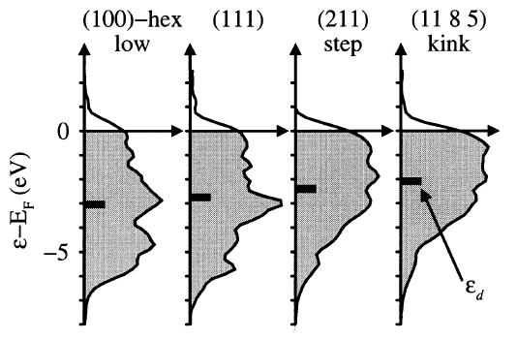
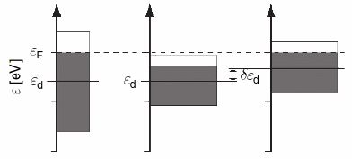
D-band Model(Chemisorption)
Variation in adsorption energies
Different Facets
ex) FCC
Band Width(W) ~ sqrt(N)
Decreasing Atomic Density
<A. Nilsson et al., Chemical Bonding at Surfaces and Interfaces, Elsevier(2008)>
<B. Hammer et al., Catalysis Letters, 46(1997), 31-35>

Slide 9
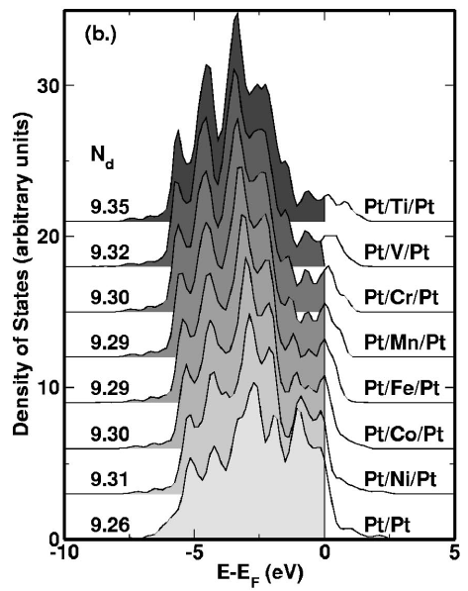
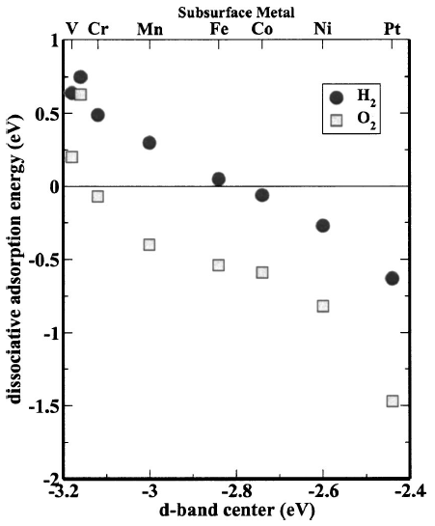
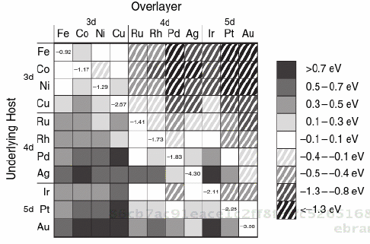
D-band Model(Chemisorption)
Variation in adsorption energies
Alloying
<J. R. Kitchin et al., J. Chem. Phys. 120, 10240 (2004)>
Control of reactivty through catalyst deposition
<A. Nilsson et al., Chemical Bonding at Surfaces and Interfaces, Elsevier(2008)>

Slide 10
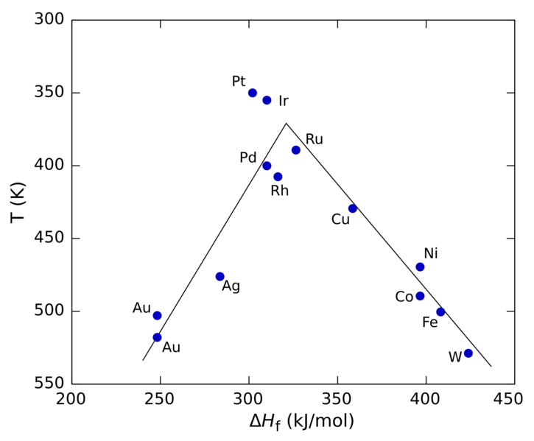
Volcano Curve
Plot of reaction rate vs property of a catalyst
(e.g. Heat of adsorption)
→ Volcano Shape
Sabatier Principle : The interaction between the
catalyst and the substrate should be “just right”
* Case of decomposition of formic acid on transition metals
<Karl Kochloefl (2005), "Heterogeneous Catalysis and Solid Catalysts“>
Activity related to various properties of a catalyst, mostly bulk properties.
The most fundamental parameter ?

Slide 11
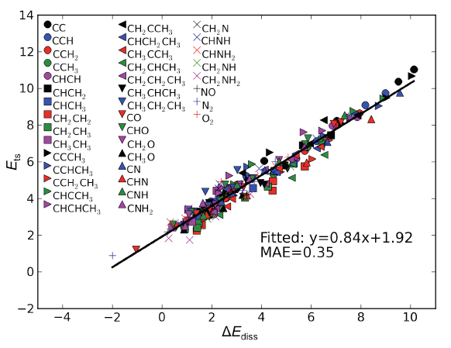
Bronsted-Evans-Polanyi(BEP) relation
Linear relationship between the activation energy
and dissociative chemisorption energy
Ea(=Ets) = aΔE + b
A2 + 2 * ↔ 2 A*
<Shengguan Wang et al., SLAC-PUB-14285>
Ea
A2 + 2 *
ΔE
Dissociative chemisorption energy determines the catalytic activity !
2 A*

Slide 12
Simple Kinetic Models
A2 + 2B ↔ 2AB
Dissociative adsorption as RDS without strongly adsorbed A2
Dissociative adsorption as RDS with strongly adsorbed A2
Dissociative adsorption as RDS followed by rxn with strongly adsorbed B
* RDS : Rate-determining step

Slide 13
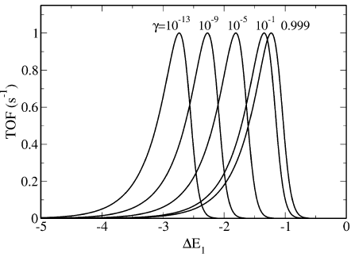
Simple Kinetic Models
Dissociative adsorption as RDS without strongly adsorbed A2
※ Assumption : Coverage of A2 and B on the surface is negligible
Ex> Ammonia synthesis
Ea
Step 1 - A2 + 2* ↔ 2A*
Step 2 - A* + B ↔ AB + *
(* : active site)
A2 + 2 * + 2B
ΔE1
2AB + 2 *
2 A* + 2B
$$r\left(T,P\right)=2k_{1}P_{A_{2}}{θ∗}^{2}\left(1−γ\right)$$
$(γ$ = Q/K)
$$=2A_{1}e^{\frac{−a∆E_{1}−b}{k_{B}T}}P_{A_{2}}{\left(\frac{1}{1+\sqrt{P_{A_{2}}γe^{\frac{∆S_{1}}{k_{B}}}e^{\frac{−∆E_{1}}{k_{B}T}}}}\right) }^{2}(1−γ)$$
<T. Bligaard et al., Journal of Catalysis 224(2004), 206-217>

Slide 14
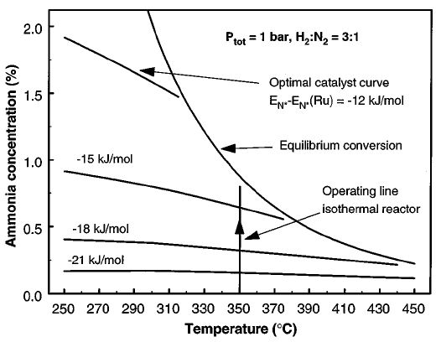
Simple Kinetic Models
Dissociative adsorption as RDS without strongly adsorbed A2
Choice of catalyst depends on deviation from equil.
More exothermic → Larger Keq → Smaller $γ$
→ Stronger dissociative chemisorption catalyst
<T. Bligaard et al., Journal of Catalysis 224(2004), 206-217>
Optimal catalyst in ammonia synthesis
<C. J. H. Jacobsen et al., Journal of Catalysis 205(2002), 382-387>

Slide 15
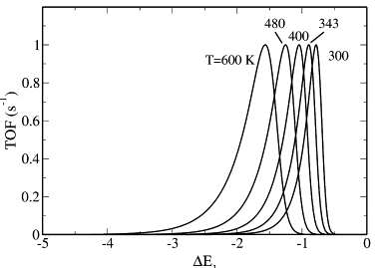
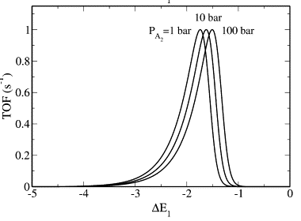
Simple Kinetic Models
Dissociative adsorption as RDS without strongly adsorbed A
Dependence on T : modest
Low temp process for noble catalysts
(smaller $\left|∆E_{1}\right|$)
<T. Bligaard et al., Journal of Catalysis 224(2004), 206-217>
Dependence on P : negligible

Slide 16
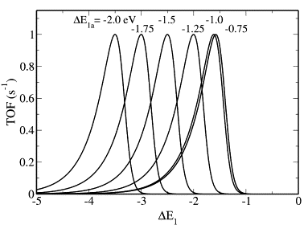
Simple Kinetic Models
Dissociative adsorption as RDS with strongly adsorbed A
Step 1 - A2 + * ↔ A2*
Step 2(RDS) - A2* + * ↔ 2A*
Step 3 - A* + B ↔ AB + *
(* : active site)
Ea1
ΔE1
A2 + 2 * + 2B
ΔE2
2AB + 2 *
A2* + * + 2B
2 A* + 2B
$$r\left(T,P\right)=2k_{2}θ_{A_{2}}θ∗\left(1−γ\right)$$
$$=2A_{2}e^{\frac{−a∆E_{2}−b+∆E_{1}}{k_{B}T}}{\frac{g(∆E_{1})P_{A_{2}}}{{(1+g\left(∆E_{1}\right)P_{A_{2}}+\sqrt{f\left(∆E_{2}\right)P_{A_{2}}γ})}^{2}}}^{}(1−γ)$$
2
<T. Bligaard et al., Journal of Catalysis 224(2004), 206-217>

Slide 17
Simple Kinetic Models
Dissociative adsorption as RDS with strongly adsorbed A
$∆E_{1}$ larger than -1eV, negligible
$∆E_{1}$ smaller than -1eV, more reactive catalyst needed(stronger binding of A)
2
<T. Bligaard et al., Journal of Catalysis 224(2004), 206-217>

Slide 18
Simple Kinetic Models
Dissociative adsorption as RDS followed by rxn with strongly adsorbed B
※ Assumption : Coverage B on the surface significant
Ea
Step 1(RDS) - A2 + 2* ↔ 2A*
Step 2 - B + * ↔ B*
Step 3 - A* + B* ↔ AB + 2*
(* : active site)
A2 + 4* + 2B
ΔE1
2ΔE2
2AB + 4*
2 A* + 2* + 2B
2 A* + 2B*
2
$$r\left(T,P\right)=2k_{1}P_{A_{2}}{θ∗}^{2}\left(1−γ\right)$$
Competition of A & B
$$=2A_{1}e^{\frac{−a∆E_{1}−b}{k_{B}T}}P_{A_{2}}{(\frac{1−\sqrt{f\left(∆E_{1}\right)P_{A_{2}}γ}}{1+g\left(∆E_{2}\right)P_{B}})}^{2} (1−γ)$$
1
<T. Bligaard et al., Journal of Catalysis 224(2004), 206-217>

Slide 19
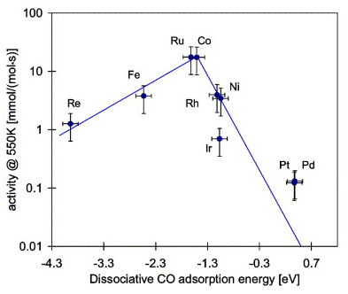
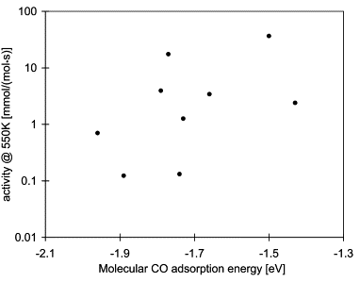
Methanation
CO + 3H2 → CH4 + H2O
(1)
(2)
-1.0 ~ -1.6eV
<T. Bligaard et al., Journal of Catalysis 224(2004), 206-217>
<T. Bligaard et al., Journal of Catalysis 224(2004), 206-217>
<M. A. Vannice, Journal of Catalysis 50(1977), 228-236>

Slide 20
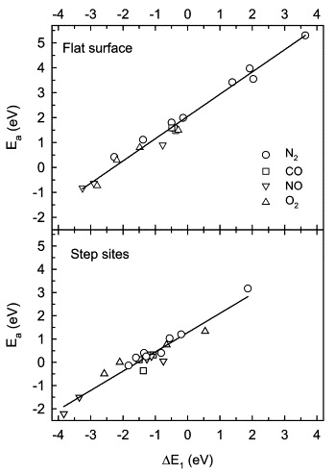
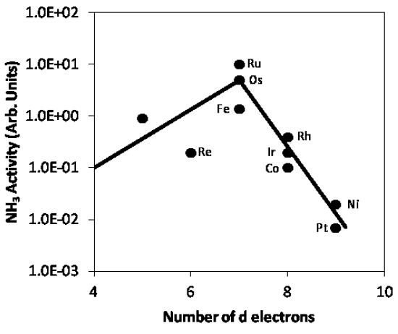
Universality of BEP relation
Ammonia Synthesis
-0.84eV
-1.27eV
-0.70eV
-0.59eV
-0.38eV
-0.10eV
1.37eV
<R. H. Anderson and M. Boudart, Catalysis: Science and Technology(1981), 87-158>
NO reduction catalysis
Pt(-1.27eV) known to be one of the best catalysts
<T. Bligaard et al., Journal of Catalysis 224(2004), 206-217>

Slide 21
Conclusions
Catalytic activity is dependent upon the adsorption of a reactant, which is determined by surface solid state of a catalyst
Dissociative chemisorption energy is the fundamental parameter leading to the Volcano Plot
BEP relation can be used to predict optimal catalysts for specific reactions in the same class

