Slide 1
Presentation
Tzu-Cheng, Chuang (莊子承)
Exchange student from
National Tsing-Hua University (Taiwan)
(國立清華大學, 台灣)

Slide 2
Where?
Russia
China
Japan
Taiwan

Slide 3
Zoom in
China
Taiwan
Hong Kong
Macau

Slide 4
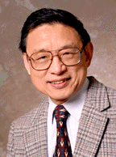
Who is from Taiwan?
Dung-Hai, Lee (李東海)
Theoretical condensed matter Physicist
Yuen-Ron, Shen (沈元壤)
Professor Emeritus Condensed Matter Physics And Materials Science

Slide 5
And…
Frank Hsia-San Shu
(徐遐生) Astrophysicist Department of Astronomy
Department chair from 1984-88
The former president of
National Tsing-Hua Univ. from 2002 ~ 2006
He was honored as the recipient of last year's (2008) Harvard Centennial Medal
The Harvard Centennial Medal, front and back (Source: Harvard University website)

Slide 6
Positronium (Ps)
TOPIC:

Slide 7
Outline
Introductions
Who predicted and who discovered positronium
States
Energy Levels
Applications

Slide 8
Introduction
First
What is the Positronium?
Is it related to Positron & Electron?

Slide 9
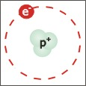
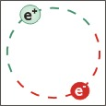
Positronium(Ps)
Metastable bound state of e⁺ and e⁻
An Exotic atom
Energy level : similar to the hydrogen atom (why?)
Exactly same as hydrogen? (reduce mass)
Hydrogen
Positronium

Slide 10
Introductions
Who predicted and who discovered positronium
States
Energy Levels
Applications

Slide 11
Who predicted positron? Who discovered positronium?
Second
Is it important?
Two persons won the Nobel Prize because of this!

Slide 12
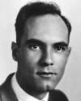
Who predicted?
Carl Anderson predicted “positron” existence in (1905-1991) 1932 while at Caltech
March 15, 1933, PRL, V. 43, The Positive Electron, Carl D. Anderson
Nobel Prize in Physics in 1936 for Positron

Slide 13
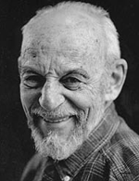
Who discovered?
Martin Deutsch the physicist who first (1917 – 2002) detected positronium in Gas
He worked on the Manhattan Project and taught at MIT
Nobel Prize in 1956 for discovering Ps

Slide 14
Introductions
Who predicted and who discovered positronium
States
Energy Levels
Applications

Slide 15
States
Third
Ground state? excited states?…or United States?

Slide 16
What we know
Ground state : like hydrogen
Electron – spin : ½
Positron – spin : ½
Why?
It’s the same as HYDROGEN !
Addition of Angular Momentum:
S = 0 v 1, m = -1, 0, 1
So what can we predict?
Singlet Triplet
state

Slide 17
Singlet State
Singlet state : anti-parallel spins (S=0, )
It is called para-positronium (Abbr. p-Ps)
1. Mean lifetime : 125 picoseconds
2. Decays preferentially into two gamma quanta, which emitted from Ps annihilation, with energy of 511 keV each
Selection rule
Mean lifetime ( ) λ is a positive number called the decay constant.
Decay function
http://www.blacklightpower.com/FLASH/Positronium.swf

Slide 18
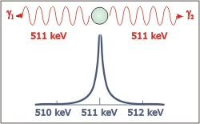
Singlet (cont.)
Doppler Broadening
to measure the energy of the gamma rays using a high-purity Germanium detector
For stationary Ps, we would expect the energy spectrum to consist of a narrow peak at 511 keV
the energy predicted by Einstein's E=mc²

Slide 19
Singlet (cont.)
p-Ps
1. decay into any even number of photons 2. the probability quickly decreases as the number increases
Ex: The branching ratio for decay into 4 photons is 1.439×10⁻⁶
Negligible!
p-Ps lifetime (S = 0):
*
S. G. Karshenboim, Precision Study of Positronium: Testing Bound State QED Theory

Slide 20
Triplet State
Triplet state : parallel spins ( )
It is called ortho-positronium (o-Ps)
*
1. In vacuum has a mean lifetime of 142.05±0.02 nanoseconds
2. The leading mode of decay is three gamma quanta.
Odd number of photon
How is the other modes of decay?
Negligible! Ex: Five photons mode’s branching ratio is 1.0* 10⁻⁶
A. Badertscher et al. (2007). "An Improved Limit on Invisible Decays of Positronium".
Phys Rev D 75

Slide 21
Triplet State Cont.
Ortho-positronium lifetime (S = 1):
*
How about the other state?
In the 2S state is metastable having a lifetime of 1.1 μs against annihilation. In such an excited state then it will quickly cascade down to the ground state where annihilation will occur more quickly
S. G. Karshenboim, Precision Study of Positronium: Testing Bound State QED Theory

Slide 23
Introductions
Who predicted and who discovered positronium
States
Energy Levels
Applications

Slide 24
Energy levels
Forth

Slide 25
Energy Levels
Using Bethe-Salpeter equation
the similarity between positronium and hydrogen allows for a rough estimate
The energy levels are different between this two because of a different value for the mass, m*, used in the energy equation
So how to calculate it?

Slide 26
Energy Level (Cont.)
Electron energy levels in Hydrogen:
But now we change the mass, m, to reduced mass, μ
Where
are the mass of electron and positron which are the same

Slide 27
Energy Level (Cont.)
So now we change the equation to
The energy is the half of the hydrogen level
The lowest energy level of positronium (n = 1) is −6.8 electron volts (eV). The next highest energy level (n = 2) is −1.7 eV, the negative sign implies a bound state

Slide 28
Conclusion
Ps is a bound state between a positron and an electron
Can be treated formally as an hydrogen atom
The Schrödinger equation for positronium is identical to that for hydrogen
Positronium is basically formed in two states, ortho-positronium with parallel spins (triplet state) para-positronium with anti-parallel spins (singlet state)
The energy difference between these spin states (hyperfine split-ting) is only 8.4x10⁻⁴ eV

Slide 29
Experiment
Sample: NO (nitric oxide)
In a gas containing molecules with an odd number of electrons, the triplet state would be converted very rapidly to the singlet
A small admixture of NO → rapid annihilation of those positron which would have decayed by three-quantum annihilation with period of 10⁻⁷
*
A. Ore, Yearbook 1949 (University of Bergen). No, 12.

Slide 30
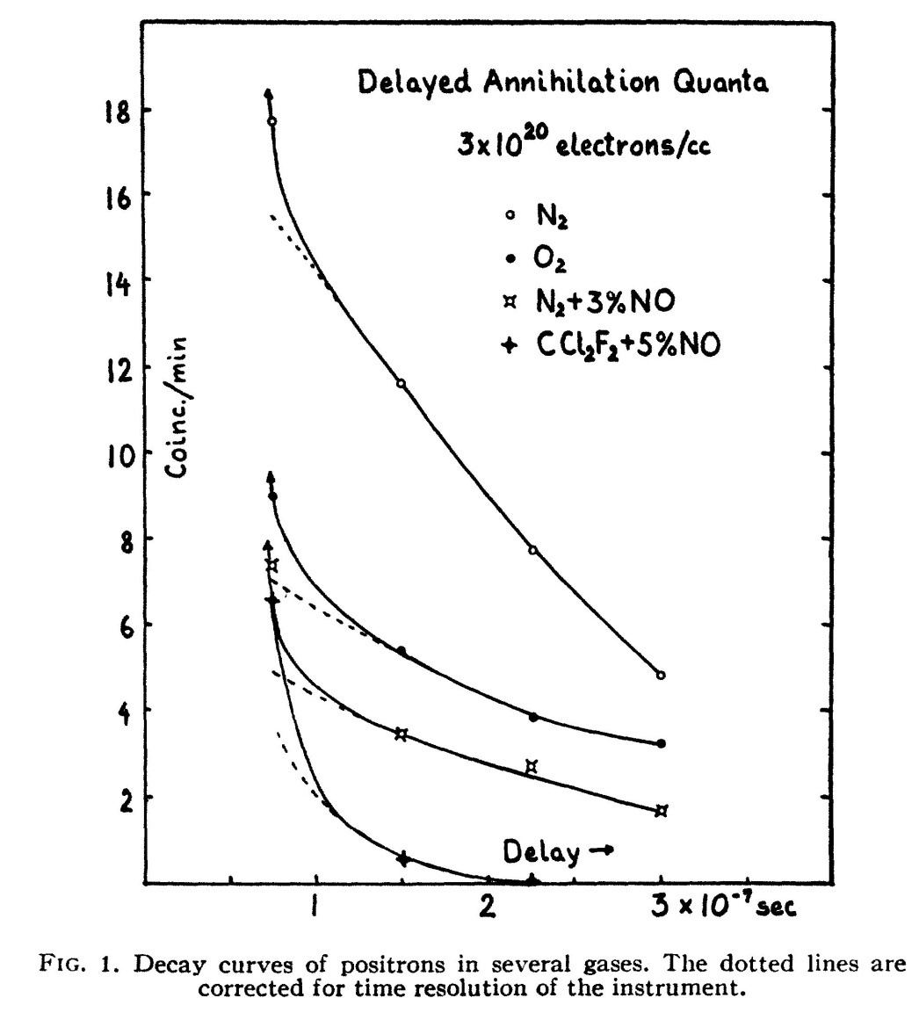
Experiment (cont.)

Slide 31
Before a new topic
Physics can be useful in our life

Slide 32
Introductions
Who predicted and who discovered positronium
States
Energy Levels
Applications

Slide 33
Application
Fifth

Slide 34
Application
What machine uses this concept?
Chapter 2
Nuclear Cardiology: Technical Applications
By Gary V Heller, April Mann, Robert C. Hendel
Edition: illustrated
Published by McGraw Hill Professional, 2008
ISBN 0071464751, 9780071464758
352 pages

Slide 35
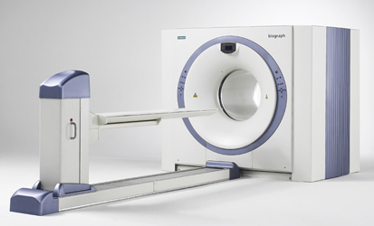
Positron emission tomography (PET)
1. A nuclear medicine imaging technique which produces a three-dimensional image of functional processes in the body
2. The system detects pairs of gamma rays emitted indirectly by a positron-emitting radionuclide (tracer)
Image of a typical positron emission tomography (PET) facility

Slide 36
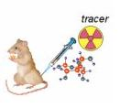
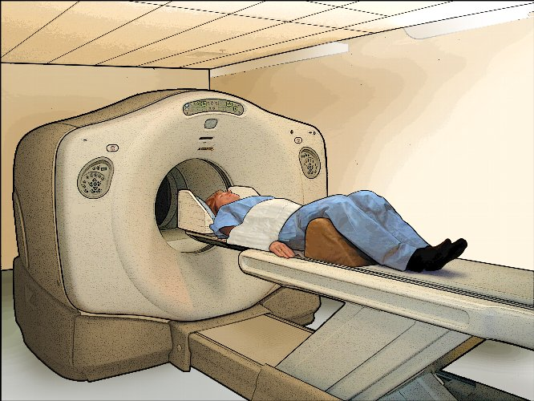
PET (cont.)
How does it work?
A short-lived radioactive tracer isotope is injected into the living subject
Waiting for a while until the active molecule becomes concentrated in tissues of interest
The object is placed in the imaging scanner
During the scan a record of tissue concentration is made as the tracer decays

Slide 37
PET (cont.)
As the radioisotope undergoes positron emission decay, it emits a positron
After travelling up to a few millimeters the positron encounters an electron, producing a pair of annihilation (gamma) photons moving in opposite directions
These are detected when they reach a scintillator in the scanning device, creating a burst of light which is detected by photomultiplier tubes
The technique depends on simultaneous or coincident detection of the pair of photons; photons which do not arrive in pairs (i.e. within a timing window of few nanoseconds) are ignored

Slide 38
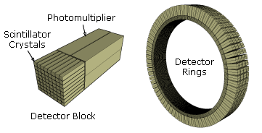
PET (cont.)
Detect the light, then processes the data
Creating a burst of light
The device detects the positron

Slide 39
PET Cont.
Localization of the positron annihilation event
The most significant fraction of electron-positron decays result in two 511 keV gamma photons being emitted at almost 180 degrees to each other; hence it is possible to localize their source along a straight line of coincidence (also called formally the line of response or LOR)

Slide 40
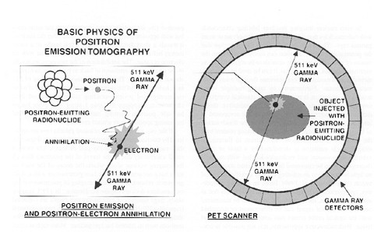
PET (cont.)

Slide 41
PET (cont.)
Image reconstruction using coincidence statistics
Using statistics collected from tens-of-thousands of coincidence events
A map of radioactivities as a function of location for parcels or bits of tissue, may be constructed and plotted
The resulting map shows the tissues in which the molecular probe has become concentrated, and can be interpreted by a nuclear medicine physician or radiologist in the context of the patient's diagnosis and treatment plan

Slide 42
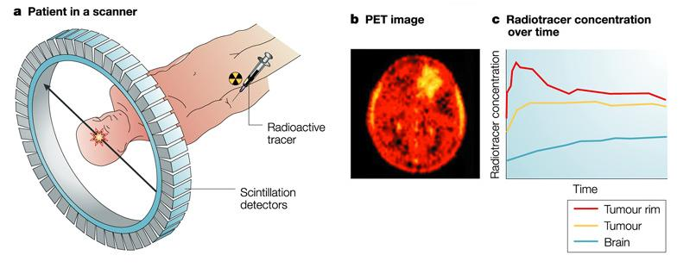
PET (cont.)

Slide 43
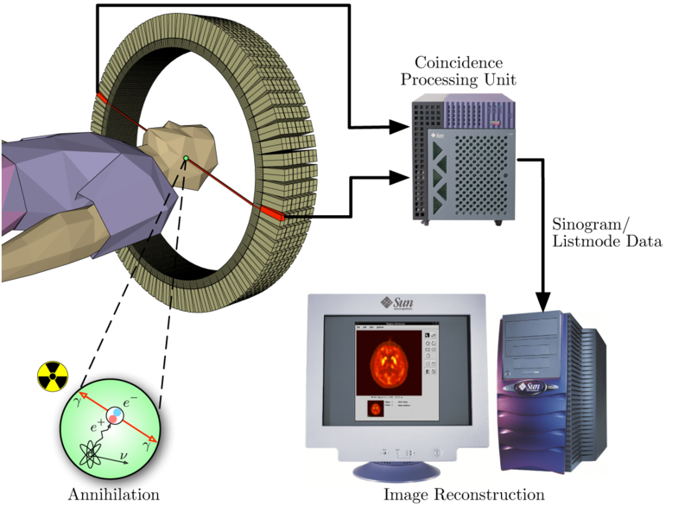
PET (cont.)
Only the pair of photons would be recorded!
Positron emits

Slide 44
Before we end this presentation

Slide 45
What professor said
the AMO Nobel Prize Winner, Prof. Carl Wieman,
this “smooth” approach DOES NOT REALY WORK

Slide 46
Reference
Y. Nagashima, et al., Thermalization of free positronium atoms by collisions with silica-powder grains, aerogel grains, and gas molecules. Phys. Rev. A 52, 258 (1995).
J. E. Blackwood, et al., Positronium scattering by He. Phys. Rev. A 60, 4454 (1999).
J. E. Blackwood, et al., Positronium scattering by Ne, Ar, Kr and Xe in the frozen target approximation. J. Phys. B 35, 2661 (2002).
K. F. Canter, et al., Positronium annihilation in low-temperature rare gases. I. He. Phys. Rev. A 12, 375 (1978).
G. Peach, Positron Spectroscopy of Solids, edited by A. Dupasquier and A.P. Mills, Jr. (IOP, Amsterdam, 1995), p. 401, cited by G. Laricchia.
M. Skalsey, et al., Doppler-broadening measurements of positronium thermalization in gases. Phys. Rev. A 67, 022504 (2003).
Akhiezer A.I., Berestetskii V.B. (1965): Quantum electrodynamics. Wiley, New York
Mogensen O.E. (1995): Positron annihilation in chemistry. Springer-Verlag, Berlin
Ferrell R.A. (1958): Phys. Rev. 110, 1355
Mogensen O.E. (1974): J. Chem. Phys. 60, 998
Rich A. (1981): Rev. Mod. Phys. 53, 127
Nico J.S., Gidley D.W., Rich A. (1990): Phys. Rev. Lett. 65, 1344
Mogensen O., Kvajic G., Eldrup M., Milosevic-Kvajic M. (1971): Phys. Rev. B 4, 71
Bisson P.E., Descouts P., Dupanloup A., Manuel A.A., Perreard E., Peter M., Sachot R. (1982): Helv. Phys. Acta 55, 100
Eldrup M., Pedersen N.J., Sherwood J.N. (1979): Phys. Rev. Lett. 43, 1407
Hyodo T. (1995): In Positron spectroscopy of solids. Dupasaquier A., Mills A.P. (eds.). Ios, Amsterdam, p. 419
Bisi A., Consolati G., Zappa L. (1987): Hyperfine Interact. 36, 29
Dannefaer S., Kerr D., Craigen D. (1996b): J. Appl. Phys. 79, 9110
Itoh Y., Murakami H. (1994): Appl. Phys. A 58, 59
Lynn K.G., Welch D.O. (1980): Phys. Rev. B 22, 99
Marder S., Hughes V., Wu C.S., Bennet W. (1956): Phys. Rev. 103, 1258
Mills A.P., Jr. (1978): Phys. Rev. Lett. 41, 1828

Slide 47
End~

Slide 48
Exotic atom
Normal atom in which one or more sub-atomic particles have been replaced by other particles of the same charge.
For example, electrons may be replaced by other negatively charged particles such as muons (muonic atoms) or pions (pionic atoms).
Because these substitute particles are usually unstable, exotic atoms typically have short lifetimes.
BACK

Slide 49
Branching ratio
For a decay, the fraction of particles which decay by an individual decay mode with respect to the total number of particles which decay. It is equal to the ratio of the partial decay constant to the overall decay constant.
Let τ be the lifetime of the decay reaction, then the decay const. is defined by , where λ is called the decay const. The branching ration for species i is then defined as
BACK

Slide 50
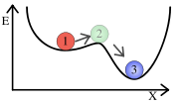
Metastable
It describes states of delicate equilibrium
A system is in equilibrium (time independent) but is susceptible to fall into lower-energy states with only slight interaction.
A metastable system with a weakly stable state (1), an interaction on it, it would become an unstable transition state(2) and finally it would go to a strongly stable state!
BACK

Slide 51
Annihilation
In physics:
Denote the process that occurs when a subatomic particle collides with its respective antiparticle
Not made into nothing but into new particle!
Conservation of energy and momentum!
Antiparticles
1. have exactly opposite additive quantum numbers from particles
2. the sums of all quantum numbers of the original pair are zero!
Hence, any set of particles may be produced whose total quantum numbers are “zero”.

Slide 52
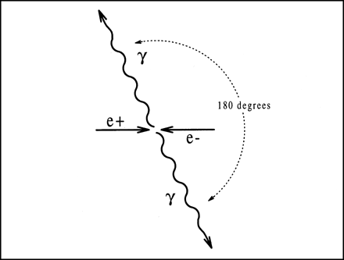
Annihilation Cont.
During a low-energy annihilation, photon (gamma ray) production is favored, since these particles have no mass.
However, high-energy particle colliders produce annihilations where a wide variety of exotic heavy particles are created.
A Feynman diagram of a positron and an electron annihilating into a photon which then decays back into a positron and an electron.
BACK

Slide 53
Bethe-Salpeter equation H. Bethe, E. Salpeter. Physical Review, vol.82 (1951), pp.309.
1. It describes the bound states of a two-body (particles) quantum mechanical system in a relativisticaly covariant formalism
2. It is in a bound state, the particles can interact infinitely often. Concurrently, since the number of interactions can be arbitrary, the number of possible Feynman diagrams will quickly exceed feasible calculations
So the equation cannot be solved exactly although the equation's formulation can in principle be formulated exactly.
BACK

Slide 54
Selection rule (transition rule)
It is a constraint on the possible transitions of a system from one state to another
They are encountered most often in spectroscopy.
For example, an electron excited by a photon can only jump from one state to another in integer steps of angular momentum (δJ = 0).
BACK

